Slide 1

Digital Portfolio
S.S.AFRIN
STUDENT NAME:
REGISTER NO AND NMID:
DEPARTMENT:
COLLEGE: COLLEGE/ UNIVERSITY
212401618
97C0408685E8EC9B7E94F5F10A031450
BCA
THIRUMURUGAN ART'S AND SCIENCE COLLEGE FOR WOMEN
/MADRAS UNIVERSITY
1
Notes:
1

Slide 2

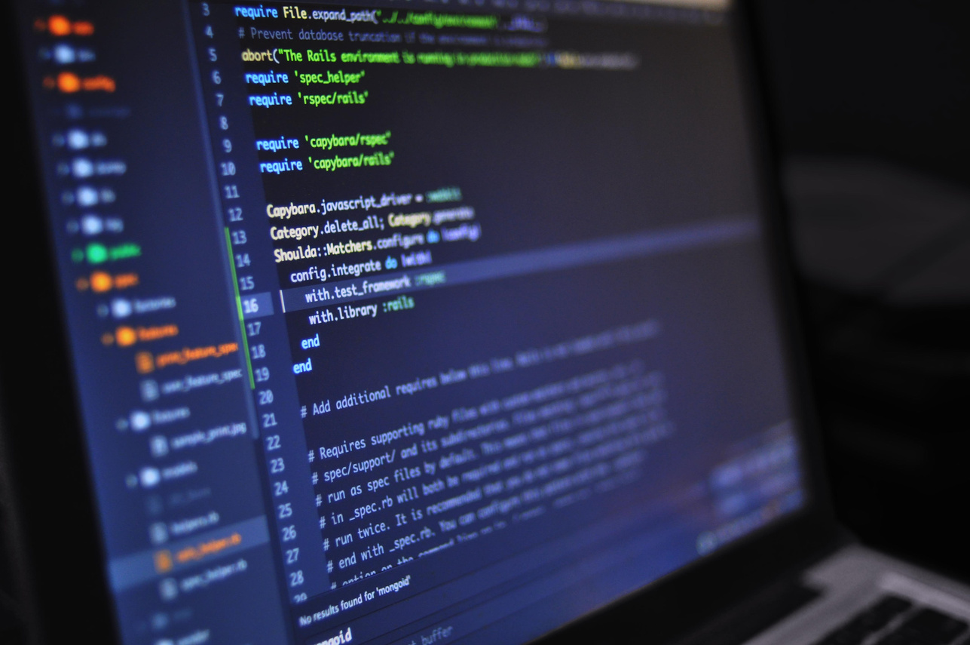
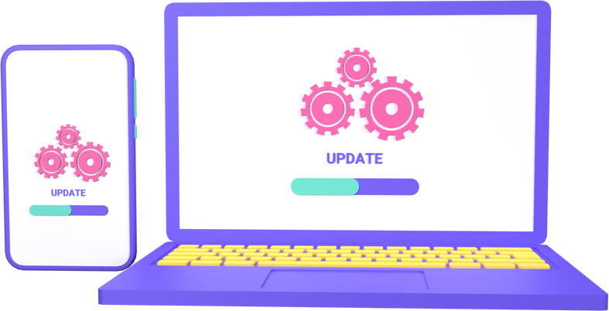
PROJECT TITLE
SOFTWARE DEVELOPER PORTFOLIO
2

Slide 3



AGENDA
Problem Statement
Project Overview
End Users
Tools and Technologies
Portfolio design and Layout
Features and Functionality
Results and Screenshots
Conclusion
Github Link
3/21/2024 Annual Review
3

Slide 4

PROBLEM STATEMENT
Many software developers face challenges in showcasing their skills, projects, and achievements in a professional and organized way. Traditional resumes often fail to reflect practical coding ability and real-time project contributions. A portfolio solves this by presenting work interactively.
4

Slide 5

PROJECT OVERVIEW
The Software Developer Portfolio is a personal website or platform that highlights a developer’s technical skills, coding projects, achievements, and career journey. It acts as a professional digital identity for recruiters, clients, and collaborators.
5

Slide 6

WHO ARE THE END USERS?
.
Recruiters & Hiring Managers
Potential Clients (for freelancing)
Technical Community (peers, collaborators)
Students & learners looking for inspiration
.
.
.
6

Slide 7

TOOLS AND TECHNIQUES
Frontend: HTML, CSS, JavaScript, React.js / Angular
Backend (optional): Node.js, Express.js
Database: MongoDB / MySQL (if dynamic)
Other Tools: GitHub, VS Code, Bootstrap, Tailwind CSS
7

Slide 8
POTFOLIO DESIGN AND LAYOUT
Home Page: Introduction & tagline
About Me: Skills, education, and experience
Projects: Detailed description with links & screenshots
Skills Section: Programming languages, frameworks, tools
Achievements/Certificates: Highlights of completed courses or awards
Contact Page: Email, LinkedIn, GitHub, social links
8

Slide 9
FEATURES AND FUNCTIONALITY
Responsive design (works on mobile & desktop)
Interactive project showcase (with live demo & GitHub links)
Downloadable resume option
Dark/Light mode toggle
Contact form with email integration

Slide 10
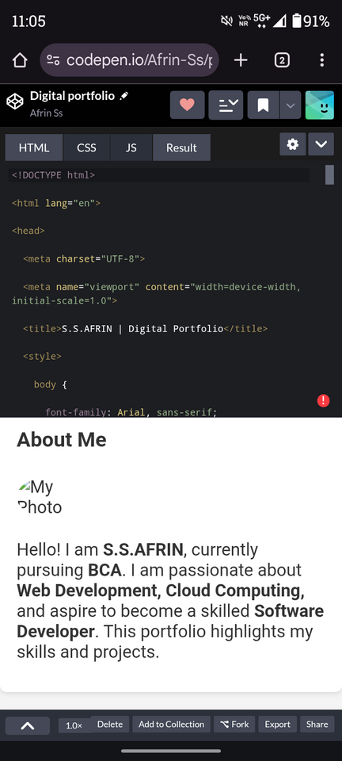

RESULTS AND SCREENSHOTS
(Add screenshots of your portfolio pages like Home, Projects, Contact, etc.)
Demonstrates technical knowledge
Professional digital presence
Easy navigation and clean UI
3/21/2024 Annual Review
10

Slide 11
CONCLUSION
A well-structured software developer portfolio is more powerful than a resume alone. It provides a live demonstration of skills, builds credibility, and increases opportunities in the job market.
11

Slide 12
